Slide 1
Heat Illness Prevention Campaign Occupational Safety and Health Administration
Notes:
Since 2011, OSHA has launched an annual nationwide heat illness prevention campaign to provide outreach and resources to workers and employers to prevent heat illness.
We have reached over 11 million workers and employees and distributed over 800,000 print resources in over 4,150 national and local informational and training sessions.
Employers are responsible for providing workplaces that are safe from recognized serious hazards, including heat.
We ask you to help disseminate the Campaigm message as well and promote the educational resources to get the message and information out. Use #(hashtag)WaterRestShade on social media to join the conversation.

Slide 2
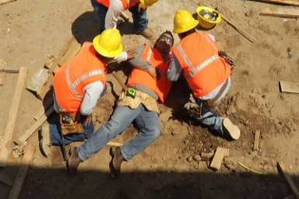
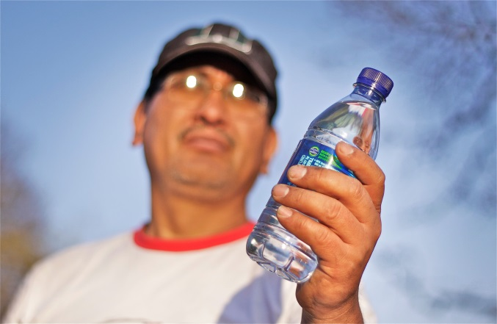
Heat Illness: Matter of Life or Death
Heat killed over 200 U.S. workers between 2009 and 2013
Occupations most affected by heat-related illnesses:
Construction
Agriculture
Building/Grounds Maintenance and Cleaning
Trade, transportation and utilities workers
Oil and Gas
Notes:
Working in the heat can be deadly.
Every year, dozens of workers die due to working in the heat and thousands become ill.
Heat illness can affect anyone, regardless of age or physical condition.
Some of the occupations most affected by heat-related illnesses are construction, agriculture, building grounds maintenance and cleaning, transportation and utility work, and support activities for oil and gas operations.
Tragically, every one of these deaths and illnesses are preventable.
OSHA wants to raise awareness about these preventable tragedies and provide resources so working in the heat doesn’t become deadly. That is why we are in our fifth year of the Campaign to Prevent Heat Illness in Workers.

Slide 3
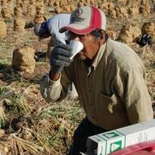
Heat Illness: Matter of Life or Death
Heat may cause cramps, heat rash, or more severe heat illnesses -- heat exhaustion and heat stroke
Some workers may not recognize the early symptoms
Heat stroke can be deadly
Early and quick action can save lives
Notes:
Many people work through early symptoms and quickly suffer from heat stroke. Temporary workers and other workers new to the job are most at risk for heat-related illnesses. It is critical to gradually increase the workload and allow more frequent breaks to help new workers and those returning to a job after some time away to acclimatize- or build a tolerance for working in the heat.
Many recent heat illness deaths have occurred in individuals younger than 40 years old in their first few days of work. Younger workers are at-risk and are dying from heat illness although many people do not believe they could be part of this risk group, since heat illness frequently affects the elderly in the general population.

Slide 4
Background: Heat Illness
Heat Illness most affects those who have not built up a tolerance to the heat, especially in the first few days on the job
Gradually building up a tolerance for work in the heat is called acclimatization
Acclimatization is an integral part of heat illness prevention programs and employers must allow time for this
Acclimatization can take up to 14 days or longer, and no one is acclimated during a heat wave.
Notes:
Heat Illness most affects those who have not built up a tolerance to the heat.
Acclimatization (ac·cli·ma·ti·za·tion) programs are an integral part of heat illness prevention programs. Acclimatization allows us to handle the heat better. The workload for new workers should be gradually increased and they should be allowed more frequent breaks especially during the first week. Workers might be at greater risk than others if they have not built up a tolerance to hot conditions because they are new to working in hot environments or they have been away from hot working conditions for more than a week. That means that even if the worker has been doing this every summer for many years, there is still an adjustment period when the weather becomes hotter. Everyone is at risk during a heat wave since the temperature is abnormally higher than usual.
Full acclimatization may take up to 14 days or longer depending on factors related to the individual or the environment.
New workers and all workers returning from a prolonged absence should begin with 20% of the workload on the first day, increasing incrementally by no more than 20% each subsequent day. During a rapid change in excessively hot weather, even experienced workers should begin on the first day of work in excessive heat with 50% of the normal workload and time spent in the hot environment, 60% on the second day, 80% on day three, and 100% on the fourth day.

Slide 5
Heat Exhaustion
Symptoms:
Treatment:
Dizziness
Headache
Sweating
Weakness
Cramps
Nausea, vomiting
Fast heartbeat
Move out of sun, lay down and loosen clothing
Apply cool, wet cloths
Move to air conditioning
Seek medical attention for evaluation and treatment.
Report to OSHA within 24 hours if an inpatient hospitalization occurs
Heat Exhaustion
Notes:
The most serious heat illnesses are heat exhaustion and heat stroke.
Symptoms of heat exhaustion are dizziness, headache, profuse sweating, weakness, cramps, nausea, vomiting, fast heartbeat, and increased body temperature.
The first-aid is to move the worker out of the sun, lay down and loosen clothing and apply cool compresses. If a worker shows signs or symptoms of heat exhaustion – call 911. Workers should be taken to a clinic or emergency room for medical evaluation and treatment. Make sure that someone stays with the worker until help arrives, because heat exhaustion can quickly become heat stroke- a medical emergency.
Remember OSHA’s new reporting requirements which require all work-related inpatient hospitalizations be reported to OSHA within 24 hours.

Slide 6
Heat Stroke
Symptoms
Treatment:
Hot, dry skin
High temperature
Confusion
Fainting
Convulsions
Heat stroke is a severe medical emergency!
Get emergency medical assistance and/or get the individual to the hospital immediately
Move the individual to a cooler, air-conditioned environment
Do not give fluids
Heat Stroke
Notes:
Heat Stroke is a severe medical emergency which requires emergency assistance. It occurs when the body’s temperature regulating system fails and the body temperature rises to critical levels and can result in death. Symptoms include hot, dry skin; high temperature, confusion, fainting and convulsions. If a worker is exhibiting any of these symptoms, call 911 and move him/her to a cooler environment.

Slide 7
We Can Prevent Heat Illness
Heat Exhaustion and Heat Stroke can be prevented:
Have a program including acclimatizion
Plan for weather hazards
Recognize signs and symptoms of heat exhaustion and heat stroke
Know when to take action
Know what to do when early symptoms are identified
Include frequent water breaks, provide shade and allow ample time to rest
Heat Exhaustion
Heat Stroke
Notes:
Employers are responsible for providing workplaces that are safe from excessive heat.

Slide 8
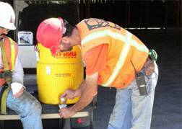
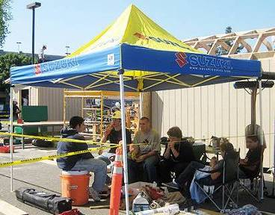
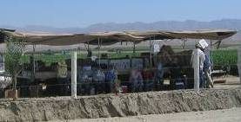
Prevention Campaign
REST
WATER
SHADE
Notes:
OSHA’s Heat Illness Prevention Campaign stresses that workers should be provided three simple things: Water, Rest, Shade.
Providing these three basics to workers is the key to protecting workers.
Employers should remind workers not to wait until they are thirsty; they should be encouraged to drink small amounts of water before they become thirsty to maintain good hydration.
Shade is very important because direct sunlight can add up to 15 degrees to the heat index, increasing the risk level by one to two categories.
The key is for employers to provide water: rest: shade. These three simple words are the simple steps needed to prevent heat problems.
Cool drinking water must be on-site and easily accessible, so workers can drink about a cup of water every 15 minutes. Shade or an air-conditioned area must also be provided for resting and cooling down. Remember- Water.Rest.Shade! Workers should also wear a hat and light weight and light-colored clothing.
OSHA's key pieces of advice to prevent heat illness are:
Drink water every 15 minutes, even if you're not thirsty.
Rest in the shade to cool down.
Wear a hat and light-colored clothing.
Learn the signs of heat illness and what to do in an emergency.
Keep an eye on fellow workers.
“Easy does it” on the first few days of work to get used to it and acclimatize.

Slide 9
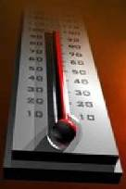
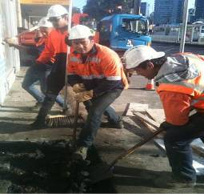
Heat Illness Prevention Guidance
Create a plan to Prevent Heat Illness
Have a Person Designated to Oversee the Heat Illness Prevention Program
Hazard Identification
Water. Rest. Shade Message
Acclimatization
Modified Work Schedules
Training
Monitoring for Signs and Symptoms
Emergency Planning and Response
Notes:
Here are some steps to prevent heat illness that the employer should use to avoid heat illness and death in workers.
Planning is important to prevent illness and death!
Employers should establish a complete heat illness prevention program to prevent heat illness.
This includes elements such as:
A Person Designated to Oversee the Heat Illness Prevention Program
Hazard Identification
Water. Rest. Shade Message
Acclimatization
Modified Work Schedules
Training
Monitoring for Signs and Symptoms
Emergency Planning and Response
Note: Below is a detailed description of each element.
Hazard Identification
Hazard identification is recognizing the hazard and tracking the risk of heat illness due to high temperature, humidity, sun exposure, and/or physiological monitoring.
Can use Wet bulb globe temperature (WBGT) thermometer, NOAA heat index, OSHA heat smartphone app
Water.Rest.Shade
Ensure cool drinking water is available and easily accessible, 1 cup every 15 minutes, and provide shade and/or air conditioned area for resting and cooling down.
Remember that direct sunlight can add up to 15 degrees to the heat index, sometimes increasing the risk level by one to two categories and making it necessary to take additional precautions.
Acclimatization
Create a schedule for all workers
Modified Work Schedules
Monitor and plan work-rescheduled work for cooler times, work/rest schedules by a competent person, rotating workers and splitting shifts, adding extra workers
Training
Health effects of heat, symptoms of heat illness, how and when to respond to symptoms, and how to prevent them in a manner and language that the worker can understand.
Monitoring for Heat Illness Symptoms
Monitoring can include medical screening, heart rate and oral temperature, water loss, or visual and verbal monitoring for alertness or any other symptoms.
Using a buddy system is important to monitor and recognize symptoms.
Emergency Planning and Response
Knowing what an emergency is, having a system in place, and communicating it to workers and supervisors can mean the difference between life and death

Slide 10
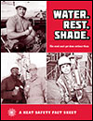
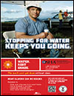
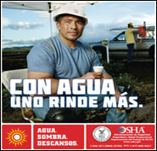
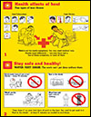
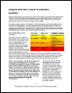
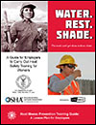
Heat Illness Prevention Resources www.osha.gov/heat
Website
Illustrated, Low-Literacy Fact Sheets
Worksite Poster
Community Poster
Training Guide
Using the Heat Index:
A Guide for Employers
Outreach Wallet Card
OSHA's Heat Smartphone App
OSHA Compliance Assistance
1-800-321-OSHA
All are free and available in SPANISH
Notes:
OSHA has developed a number of resources to raise awareness, educate workers and employers about the dangers of heat illness and guidance to prevent it in the workplace. They are available in English and Spanish on OSHA’s website.
Illustrated, Low-Literacy Fact Sheets have pictured heat illness symptoms and prevention strategies.
Worksite Poster is a Poster to hang in worksite with heat illness symptoms and prevention strategies. Community Poster is an awareness poster with heat illness prevention messages and OSHA contact information.
OSHA Heat Illness Prevention Training Guide is a guide to carry out heat safety training, with short lesson plans that can be used during tailgate or toolbox talks.
Using the Heat Index: A Guide for Employers is a guide to planning for heat at the workplace and taking precautions based on heat index. Describes work/rest schedules, precautions to take based on the heat index and how to take them, training, and checklists.
Outreach Wallet Card is a two-sided business card with message on one side and heat illness symptoms on the other. QR Code links to OSHA Heat Illness Prevention Website to access more materials. Can be kept in wallet to use in event of an emergency and great to hand out at worksites.
OSHA's Heat Smartphone App App calculates heat index for current location and provides guidance to prevent illness.
All of these resources are available in Spanish! There are links to some resources available in other languages on the website.

Slide 11
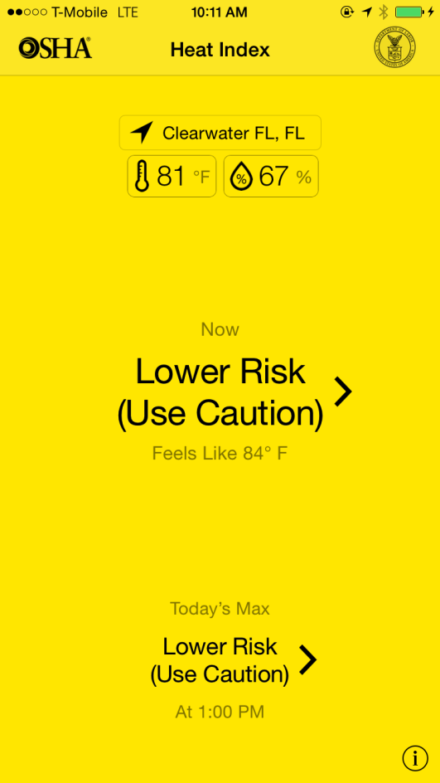
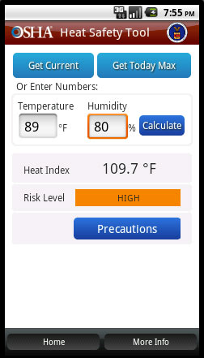
OSHA Smartphone App
Calculates heat index
Displays risk level
Provides protective measures (precautions) based on risk
Notes:
We also have a mobile smart phone app to help protect workers. We just released a new version for the apple devices in 2015. The app is available for apple and android phones intended to provide users with specific heat risk level and precautions to take based on their location. It also provides information about the temperature throughout the day to help employers and workers plan for extreme weather. The new version, available for apple devices, now offers full screen color alerts and improved navigation capability.
There are also reminders about drinking enough fluids, scheduling rest breaks, planning for and knowing what to do in an emergency, adjusting work operations, gradually building up the workload for new workers, training on heat illness signs and symptoms, and monitoring each other for signs and symptoms of heat-related illness.
Join the almost 200,000 people and counting who have downloaded it too and download it as well, use it throughout the day to get the latest recommendations based on your location.

Slide 12
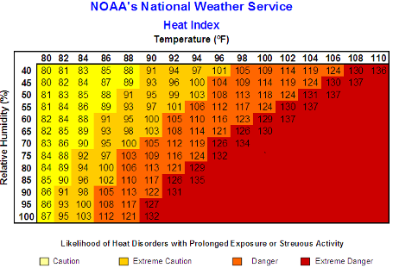
National Weather Service http://www.nws.noaa.gov/om/heat/index.shtml
Partnering with the National Oceanic and Atmospheric Administration’s (NOAA) National Weather Service (NWS) on weather service alerts before and during extreme heat.
Notes:
OSHA uses the National Weather Service’s (NWS) heat index as a framework for triggering recommending precautions to protect outdoor workers from environmental heat and works with the National Weather Service to include language for workers and employers in all heat advisories and warnings.
(Optional)National Oceanic Atmospheric Administration (NOAA )/ National Weather Service (NWS)Message in Heat Advisory Products:
Take extra precautions if you work of spend time outside. When possible, reschedule strenuous activities to early morning or evening.
Know the signs and symptoms of heat exhaustion and heat stroke.
Wear light weight and loose fitting clothing when possible and drink plenty of water.
To reduce risk during outdoor work, the Occupational Safety and Health Administration recommends scheduling frequent rest breaks in shaded or air conditioned environments.
Anyone overcome by heat should be moved to a cool and shaded location. HEAT STROKE is an emergency – Call 911

Slide 13
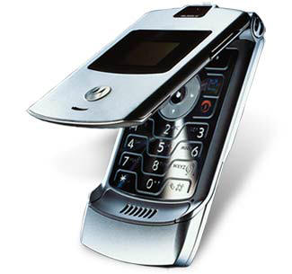
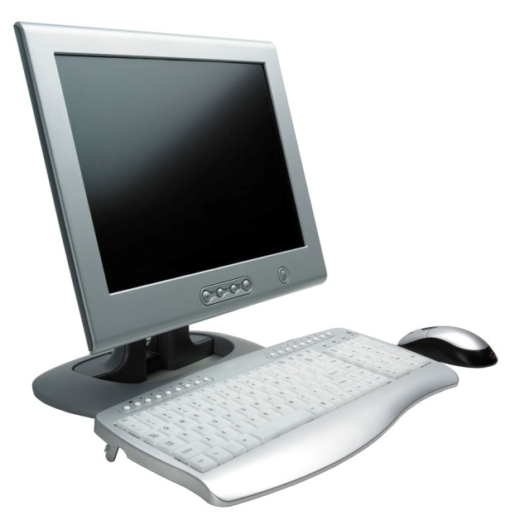
Compliance Assistance
OSHA offers compliance assistance to employers:
Contact OSHA
1-800-321-OSHA (6742). It’s free.
For other compliance assistance information and services…
www.osha.gov
Occupational Safety
and Health Administration
U. S. Department of Labor
Notes:
Additional information about heat illness and the OSHA resources available to assist you in addressing this hazard can be found at www.osha.gov or by contacting OSHA at 800-321-6742.

Slide 14
Heat Illness “Quiz”
Name some symptoms of Heat Illness:
Name some levels of Heat Illness:
Dizziness, Nausea, Vomiting, Headache, Thirst, Irritability, Confusion
Heat Rash, Cramps, Exhaustion, Stroke, Death
Notes:
Note to presenter: If training time allows this slide can be used in conjunction with the OSHA Fact Sheet, Quick Card, Poster or Employer Guide. Please feel free to create industry or audience specific questions.

Slide 15
Heat Illness “Quiz”
All workers need is water right?
Only supervisors need to know what to do in a heat emergency.
NO! Water, Rest, Shade, and Acclimatization
NO! Employers must train all workers- not just supervisors.
Notes:
Note to presenter: This slide can be used in conjunction with the OSHA Fact Sheet. Please feel free to create industry or audience specific questions.

Slide 16
Thank you!
Questions?

